Slide 1

What Is “the Cloud”?
https://tinyurl.com/windGH

Slide 2
The Cloud is like a big computer in the sky.
It stores information and helps apps work together.
We can ask it for things, like the weather, and it sends answers back!

Slide 3

What Is an Extension?

Slide 4
An extension adds new blocks to our LEGO code.
It lets our robot learn new tricks.
For example, we can use a Weather Extension to know if it’s sunny or rainy!

Slide 5
What Is the LEGO Weather Extension?
It can tell us what the weather is in our town!
It talks to the Cloud and gets information, like “sunny,” “rainy,” or “windy.”
Then our LEGO model can react, light up, move, or show pictures.

Slide 6
How Does It Work?
Our program sends a message to the Cloud.
The Cloud checks the weather.
It sends the weather back to SPIKE.
Our LEGO hub does something fun with that info!

Slide 7
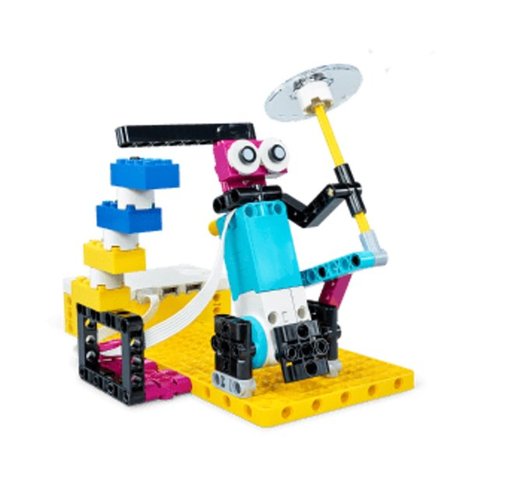
The project

Slide 8
Go to this link
tinyurl.com/windGH

Slide 9
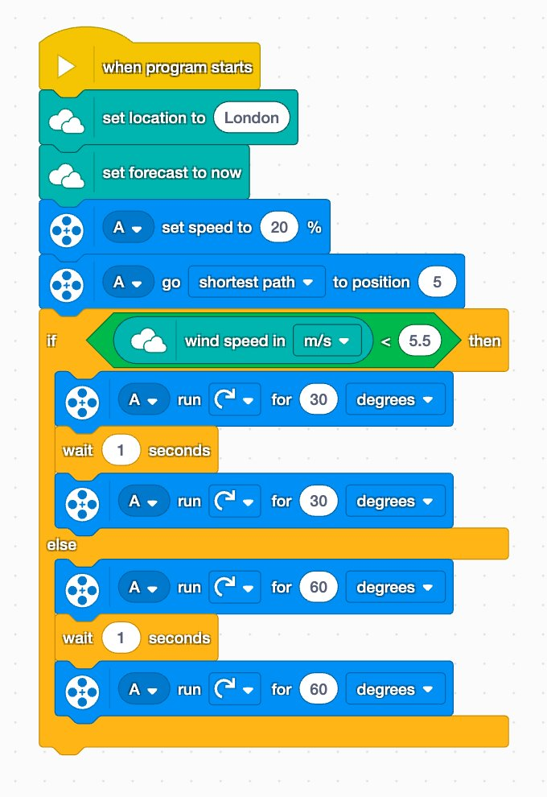
The code

